Slide 1

Class - 04
All about Linear Regression
aiQuest
Theory Part:
Straight Line
Curve Line
Slope
Intercept
Cost Function
Lose Function
Mean Absolute Error (MAE)
Mean Squared Error (MSE)
Gradient Decent
Coding with Python:
Implementing Linear Regression
Simple ML Project on Rent Prediction
Discussion on Assignment:
Weight Prediction Based on Height

Slide 2
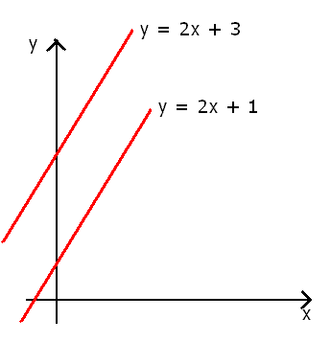
Class - 04
All about Linear Regression
aiQuest
X = 10, 30, 50
Y = 2*10 + 3 =23
Y = 2*30 + 3 = 63
Y = 2*50 + 3 = 103
Fig: Straight Line

Slide 3
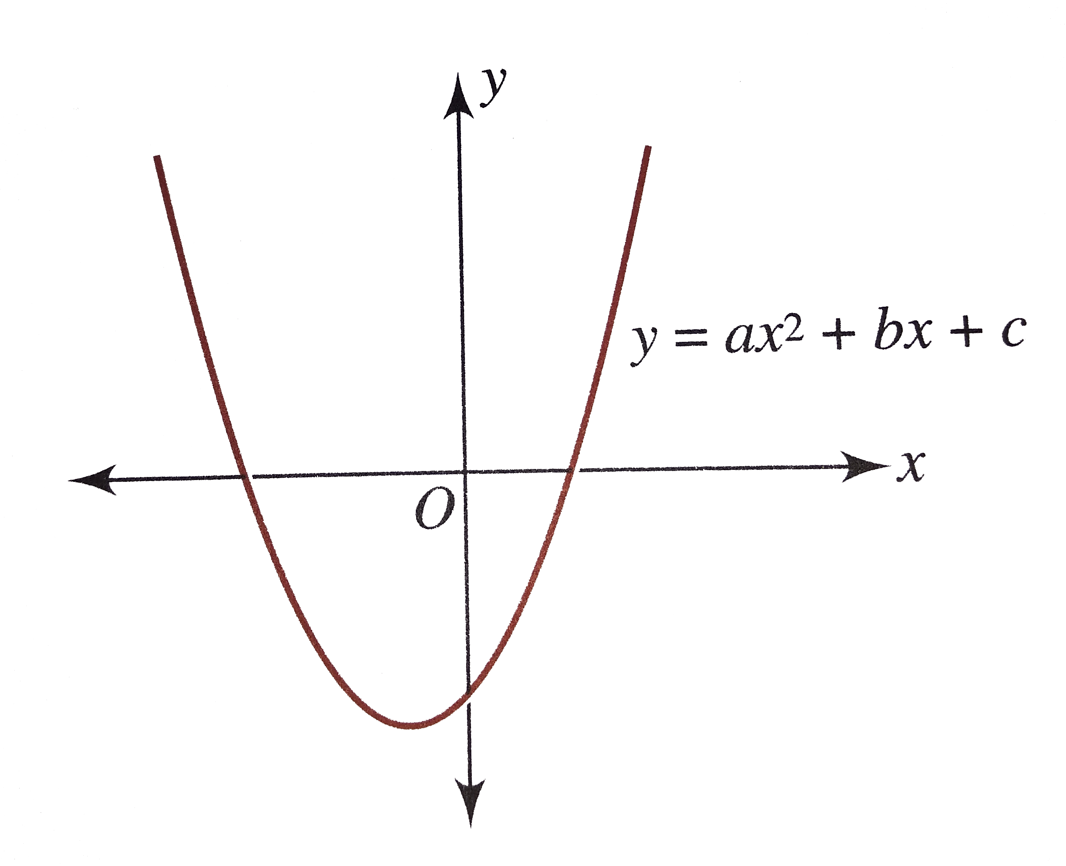
Class - 04
All about Linear Regression
aiQuest
Fig: Curve Line

Slide 4
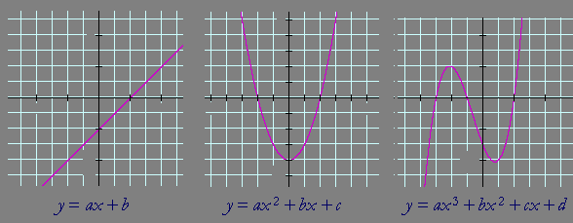
Class - 04
All about Linear Regression
aiQuest
Fig: Lines

Slide 5
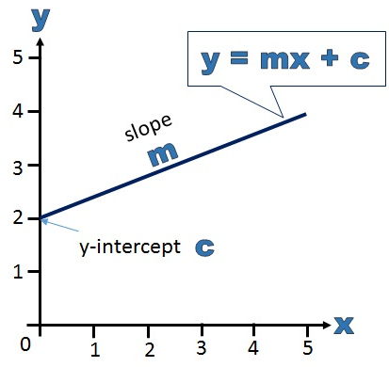
Class - 04
All about Linear Regression
aiQuest

Slide 6
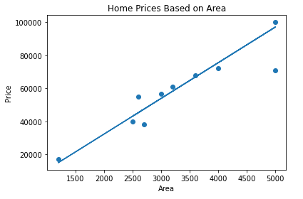

Class - 04
All about Linear Regression
aiQuest
y = mx + b ; or,
Y = 21.43* X + 4980.13
1
Best Fit Line
Coefficient = 21.43
Intercept = 4980.13

Slide 7
Class - 04
All about Linear Regression
aiQuest
y = mx + b ; or,
Y = 21.43* X + 4980.13
1
Best Fit Line
Coefficient = 21.43
Intercept = 4980.13

Slide 8
Class - 04
All about Linear Regression
aiQuest
y = mx + b ; or,
Y = 21.43* X + 4980.13
1
Best Fit Line
Coefficient = 21.43
Intercept = 4980.13

Slide 9
Class - 04
All about Linear Regression
aiQuest
y = mx + b ; or,
Y = 21.43* X + 4980.13
1
Best Fit Line
Coefficient = 21.43
Intercept = 4980.13

Slide 10
Class - 04
All about Linear Regression
aiQuest
y = mx + b ; or,
Y = 21.43* X + 4980.13
1
Best Fit Line
Coefficient = 21.43
Intercept = 4980.13

Slide 11
Class - 04
All about Linear Regression
aiQuest
y = mx + b ; or,
Y = 21.43* X + 4980.13
1
Best Fit Line
Coefficient = 21.43
Intercept = 4980.13

Slide 12
Class - 04
All about Linear Regression
aiQuest
y = mx + b ; or,
Y = 21.43* X + 4980.13
1
Best Fit Line
Why this is Best fit line?
Coefficient = 21.43
Intercept = 4980.13

Slide 13
Class - 04
All about Linear Regression
aiQuest
y = mx + b ; or,
Y = 21.43* X + 4980.13
1
Best Fit Line
How can we draw it?
Coefficient = 21.43
Intercept = 4980.13

Slide 14
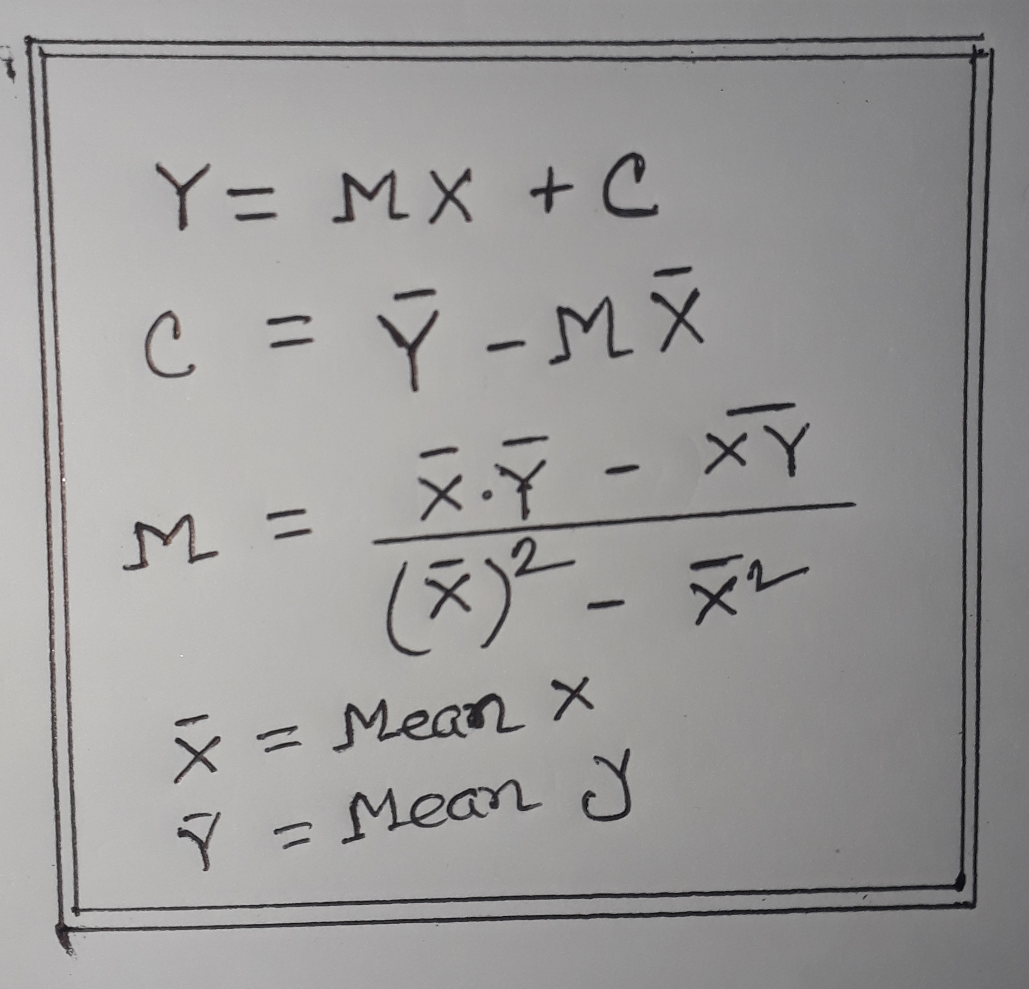
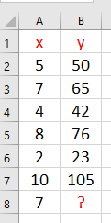
Class - 04
All about Linear Regression
aiQuest
Formula of Linear Regression
Data Set
Now
Solve it

Slide 15
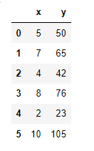
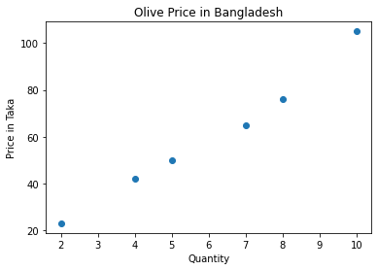
Class - 04
All about Linear Regression
aiQuest

Slide 16
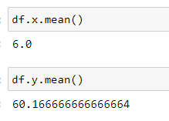
Class - 04
All about Linear Regression
aiQuest
Mean Values

Slide 17
Class - 04
All about Linear Regression
aiQuest
Mean Values

Slide 18
Class - 04
All about Linear Regression
aiQuest
Mean Values

Slide 19
Class - 04
All about Linear Regression
aiQuest
Formula of Linear Regression
Data Set
Now
Solve it

Slide 20
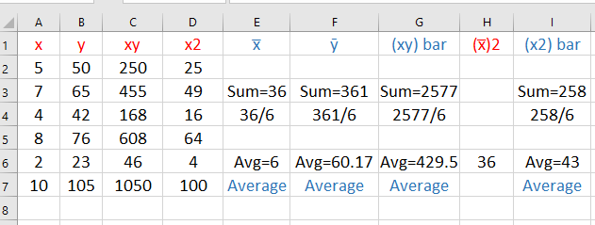
Class - 04
All about Linear Regression
aiQuest
Calculation Table for Single Variable Linear Regression

Slide 21
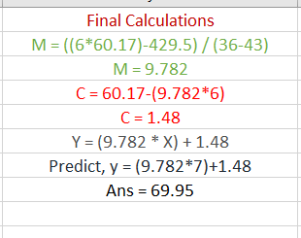
Class - 04
All about Linear Regression
aiQuest
Formula of Linear Regression

Slide 22
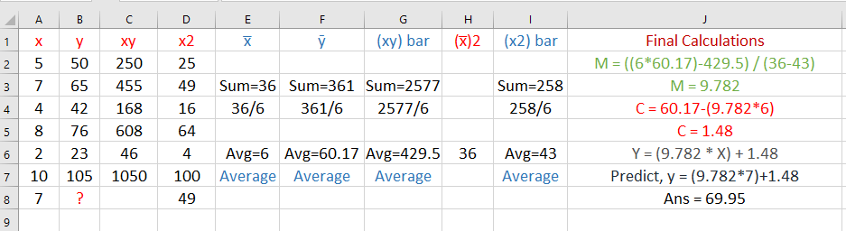
Class - 04
All about Linear Regression
aiQuest

Slide 23
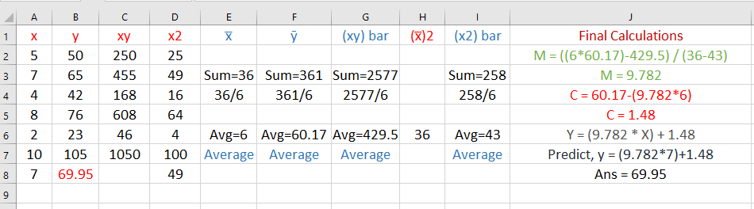
Class - 04
All about Linear Regression
aiQuest

Slide 24
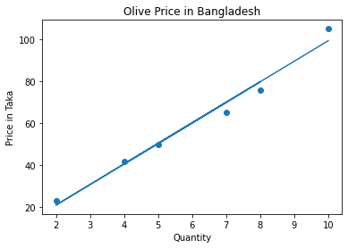
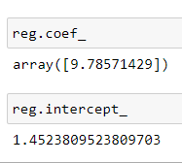
Class - 04
All about Linear Regression
aiQuest
Data Set
Value of M & C
Line

Slide 25
Class - 04
All about Linear Regression
aiQuest
Data Set
Value of M & C

Slide 26
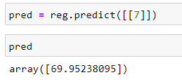
Class - 04
All about Linear Regression
aiQuest
Data Set
Predict New Value
Line

Slide 27
Class - 04
All about Linear Regression
aiQuest
Cost Function
The cost function is a function, which is associates a cost with a decision.
Map
Dhanmondi
Dhanmondi
Dhanmondi
Dhanmondi
Dhanmondi

Slide 28
Class - 04
All about Linear Regression
aiQuest
Cost Function
The cost function is a function, which is associates a cost with a decision
Map
50 min
55 min
30 min
40 min
20 min
Dhanmondi
Dhanmondi
Dhanmondi
Dhanmondi
Dhanmondi

Slide 29
Class - 04
All about Linear Regression
aiQuest
Cost Function
The cost function is a function, which is associates a cost with a decision
Map
Cost Function
50 min
55 min
30 min
40 min
20 min
Dhanmondi
Dhanmondi
Dhanmondi
Dhanmondi
Dhanmondi

Slide 30
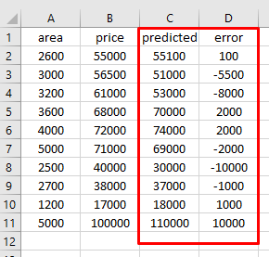
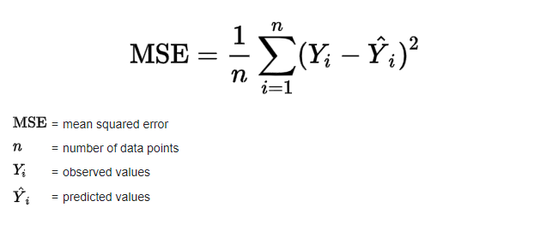
Class - 04
All about Linear Regression
aiQuest
Loss & Cost Function
A loss function is for a single training example. It is also sometimes called an error function. A cost function, on the other hand, is the average loss over the entire training dataset. The optimization strategies aim at minimizing the cost function
Predicted Price (Y) = m * area + c
L1 Loss (error) = 1/n | (yi – y^) |
Yi = Area for each row
Y^ = Predicted Value

Slide 31
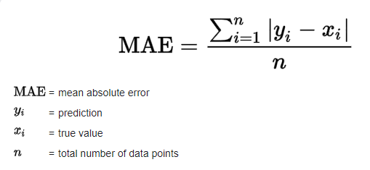
Class - 04
All about Linear Regression
aiQuest
Cost Function
The cost function is a function, which is associates a cost with a decision. It indicates the difference between the predicted and the actual values for a given dataset. An ideal value of the cost function is zero. In regression, the typical cost function (CF) used is the mean squared error (MSE) cost function. The form of the function is shown below.

Slide 32
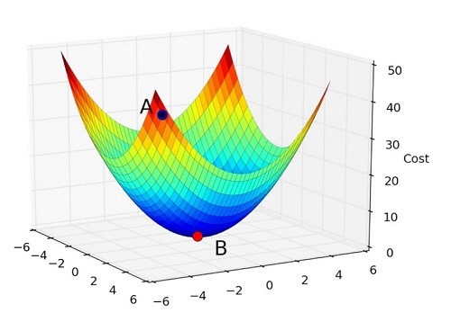
Class - 04
All about Linear Regression
aiQuest
Minimizing the cost function: Optimizer Gradient Descent
MSE (COST)

Slide 33
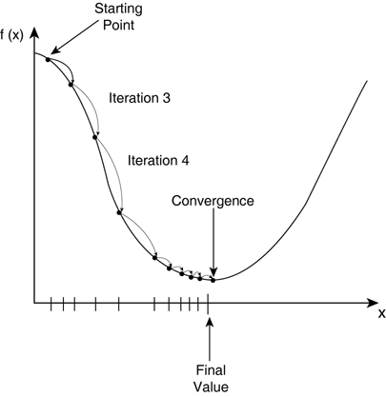
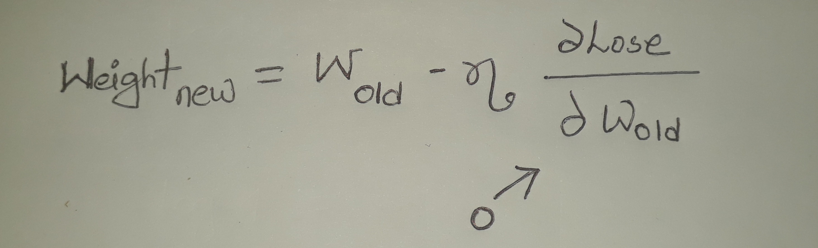
Class - 04
All about Linear Regression
aiQuest
Minimizing the cost function: Optimizer Gradient Descent
m=c=0
Gradient descent is an efficient optimization algorithm that attempts to find a local or global minima of a function. At this point the model has optimized the weights such that they minimize the cost function. Gradient descent enables a model to learn the gradient or direction that the model should take in order to reduce errors
MSE (Cost)
Global Minima
Weight (W)

Slide 34
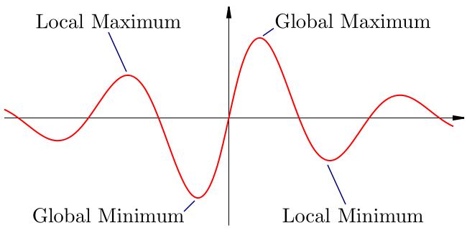
Class - 04
All about Linear Regression
aiQuest
Minimizing the cost function: Gradient Descent

Slide 35
Class - 04
All about Linear Regression
aiQuest
Let’s Implement Linear Regression with Python

